Slide 1
Before We Start Make Sure that…
You have cloned SMS interceptor from git@github.com:abhinavmanchanda/smsinterceptor.git

Slide 2
Agenda
Application Components
SMS interceptor
Signing and publishing on Play Store
Feedback
Asynchronous Server calls Demo

Slide 3
Basics
Project Structure
Android Manifest
Resource Files
Source Code
Application Components
Activities
Services
Broadcast Receivers
Content Providers
Intents
Action
Data
Intent Filters
Tests
Junit or Android Junit ?
Instrumentation API and ActivityInstrumentationTestCase2 or Robolectric

Slide 4
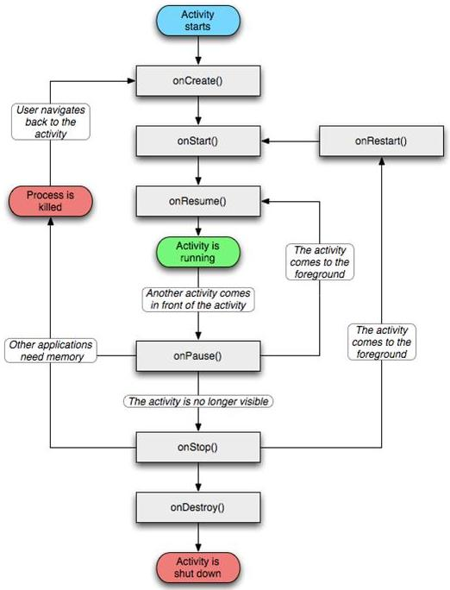

Slide 5
SMS Interceptor
Broadcast Receivers
Read incoming SMS data
Show toast

Slide 6
Signing and Publishing
Create a release keystore
Sign the app using the release keystore
Publish it to Google Play Store

Slide 7
Feedback

Slide 8
Asynchronous Server calls Demo
Prevent UI blocking by performing server calls in background thread.
Callbacks.

